Slide 1

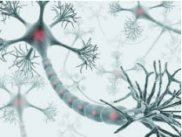
Neural Network
Multilayer Neural Network
Abdelwahab Naji - Enseignant chercheur
Abdelwahab.naji@gmail.com
Laboratoire Signaux, Systèmes Distribués et Intelligence Artificielle (SSDIA)
ENSET de Mohammedia, Université Hassan II de Casablanca
https://www.youtube.com/c/AbdelwahabNaji

Slide 2

Supervised Learing
Unsupervised Learing
Reinforcement Learning
Random forest
Decision Tree
Linear Regression
Don’t start with theory
Deployment
SVR
SLNN
Begin with a simple problem
Techniques
Neural network
MLNN
Begin with a simple technique
Definition
Regression
R-squared
MSE
RSE
AIC
…
Performance
Use simple dataset
Problems
ML -Categories of Learning
Decision trees
Techniques
KNN
Using librairies
ML Tools
Naive bayes
ML Librairies (Black Box) :
sklearn, Keras, PyTorch ..
ML problem Domains
Classification
Binary Classification
Multi-Class Classification
Multi-Label Classification
Neural network
Random forest
Math Librairires:
NumpY, SciPy…
Algorithms
Classification Accuracy
Logarithmic Loss
Confusion Matrix
Area under Curve
F1 Score
Performance
Support Vector Machine
ML & Math
Artificial intelligence
How to Learn?
…
who are you?
Calculus
Linear Algebra
Statictics
probability
Machine Learning
-
-
Techniques
K-means
Clustering
DBScan
Deep Learning
Davies-Bouldin Index
Dunn Index
Silhouette Coefficient
From scratch & by hand
Performance
hierarchical clustering
Programming Languages
How it works?
Algorithmis
Math
Dimentiality Reduction
…
Data Analysis
Python
Scala
Java
R
C++
Matlab
ML
LifeCycle
Analysis Librairies
pandas
Techniques
Ratio of missing values
-
Data Visualization
Low variance in the column values
spider
jupyter Notebook
Data preprocessing
Preprocessing Librairies
sklearn.preprocessing
Visualization Librairies Matplotlib, Seaborn
Backward feature elimination
…

Slide 3
Mise en œuvre de Neural Network: les étapes à suivre
NN (un seul neurone) avec tensorflow, keras
Problème linéairement séparable vs problème non linéairement séparable
Loss function
Exemple 1: generated data pour un problème linéairement séparable
Exemple 2: diabetes dataset
NN (un seule Neurone) from scracth avec gradient descent
Traiter les mêmes exemples
NN: Multi – Layer (plusieurs neurones) avec tensorflow, keras
Problème non linéairement séparable
Exemple 1: XOR problem
Exemple 2: fashion classification problem
Exemple 3: hand written digits classification problem
Exemple 4: diabetes classification problem
NN: Multi – Layer (plusieurs neurones) from scratch avec gradient descent
Traiter les mêmes exemples

Slide 4
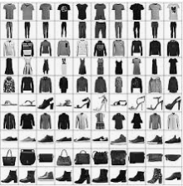
Dataset
Class | Description
0 | T-shirt/top
1 | Trouser
2 | Pullover
3 | Dress
4 | Coat
5 | Sandal
6 | Shirt
7 | Sneaker
8 | Bag
9 | Ankle boot
https://keras.io/api/datasets/fashion_mnist/

Slide 5


Problem
Image 28x28
Human
Trouser
NN
Image 28x28
Computer
Trouser

Slide 6
Input Layer
hidden layer
Output layer
bias
bias
0
1
Class | Description
0 | T-shirt/top
1 | Trouser
2 | Pullover
3 | Dress
4 | Coat
5 | Sandal
6 | Shirt
7 | Sneaker
8 | Bag
9 | Ankle boot
784
2
Image 28x28
3
4
.
.
.
.
.
.
5
6
7
8
9
784 Neurones
20 Neurones
10 Neurones

Slide 7
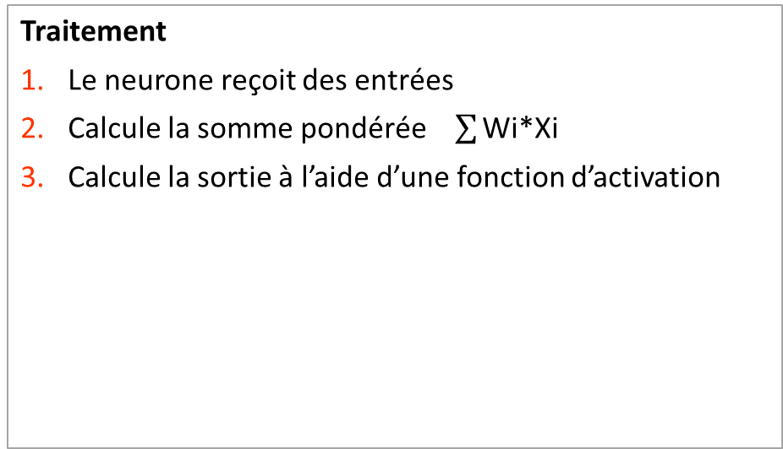
Neurone
X1
W1
X2
W2
.
.
.
output
s=w1*X1+w2*X2+…Wm*Xm
Activation_funct(s)
weighted sum
Wm
Xm
Traitement
Le neurone reçoit des entrées
Calcule la somme pondérée $\sum{\text{Wi}\text{∗}\text{Xi}}$
Calcule la sortie à l’aide d’une fonction d’activation
Element
Inputs
Weights
Activation function
Sigmoid
Relu
Softmax

Slide 8
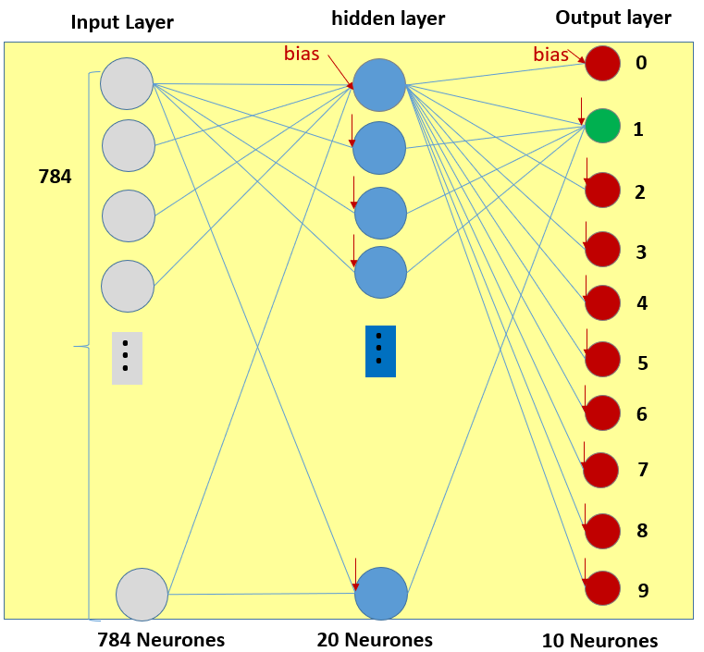
Learning
fit(dataset): update weights
Prediction
predict(newdata): output
Element
Input Layer
Hidden Layers
Output Layer

Slide 9
Multilayer Neural Network by using tensorflow, keras

Slide 10
Les étapes à suivre pour créer le modèle
Data
Get data, Features (X), target (y)
Visualize data
Split Data (training data, test data)
Model
Create the model, compile the model: keras, tensorflow
Optimizer function: adam
Loss function: sparse_categorical_crossentropy
Train the model
Parameters
Prediction
Evaluation

Slide 11
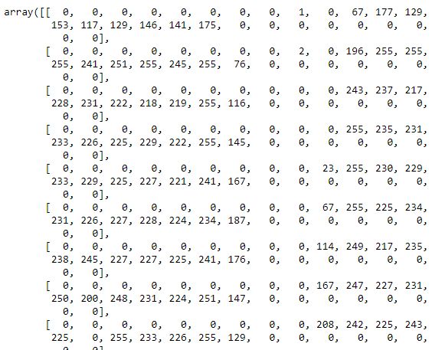
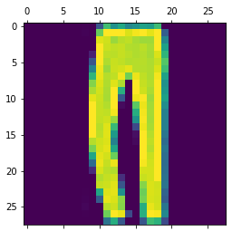
1. Dataset
Class | Description
0 | T-shirt/top
1 | Trouser
2 | Pullover
3 | Dress
4 | Coat
5 | Sandal
6 | Shirt
7 | Sneaker
8 | Bag
9 | Ankle boot
import keras
dataset = keras.datasets.fashion_mnist
(X_train, y_train), (X_test, y_test) = dataset.load_data()
X_train.shape
(60000, 28, 28)
y_train.shape
(60000, )
X_test[2]
y_test[2]
1
plt.matshow(X_test[2])
X_train = X_train/255
X_test = X_test/255

Slide 12
Les étapes à suivre pour créer le modèle
Data
Get data, Features (X), target (y)
Visualize data
Split Data (training data, test data)
Model
Create the model, compile the model: keras, tensorflow
Optimizer function: adam
Loss function: sparse_categorical_crossentropy
Train the model
Parameters
Prediction
Evaluation

Slide 13
Plusieurs fonctions pour évaluer cost
Binary
BinaryCrossentropy class
CategoricalCrossentropy class
SparseCategoricalCrossentropy class
Poisson class
binary_crossentropy function
categorical_crossentropy function
sparse_categorical_crossentropy function
…

Slide 14
Optimzer functions sont basés sur l’algorithme Grandient Descent
Plusieurs variantes de l’algorithme sont disponibles
Batch Gradient Descent
Stochastic Gradient Descent
Mini Batch Gradient Descent
Adagrad
Adamax
RMSprop
Adam
…

Slide 15
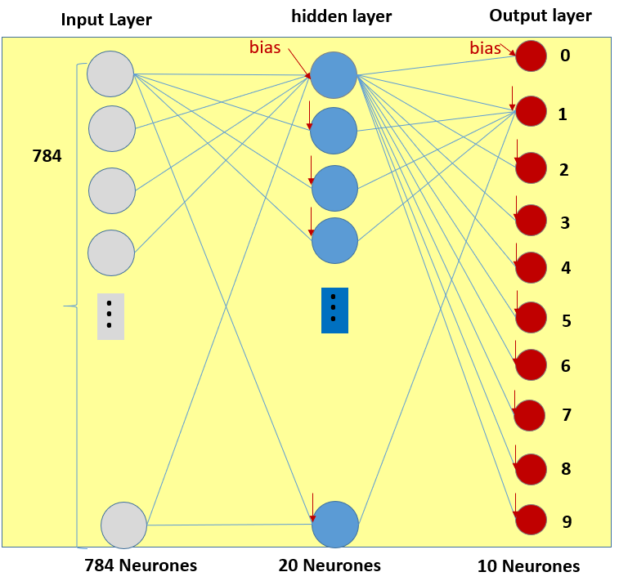
2. Model
from keras.models import Sequential
from keras.layers import Flatten, Dense, Activation
model = Sequential()
input_layer=Flatten(input_shape=[28, 28])
model.add(input_layer)
hidden_layer=Dense(20,activation="relu")
model.add(hidden_layer)
output_layer=Dense(10, activation="softmax")
model.add(output_layer)
print(model.summary())
print(model.get_weights()) #initial weights
model.compile(loss="sparse_categorical_crossentropy",
optimizer="adam",
metrics=["accuracy"])
model.fit(X_train, y_train,epochs=10)
print(model.summary())
print(model.get_weights()) #learned weights

Slide 16
Les étapes à suivre pour créer le modèle
Data
Get data, Features (X), target (y)
Visualize data
Split Data (training data, test data)
Model
Create the model, compile the model: keras, tensorflow
Optimizer function: adam
Loss function: sparse_categorical_crossentropy
Train the model
Parameters
Prediction
Evaluation

Slide 17
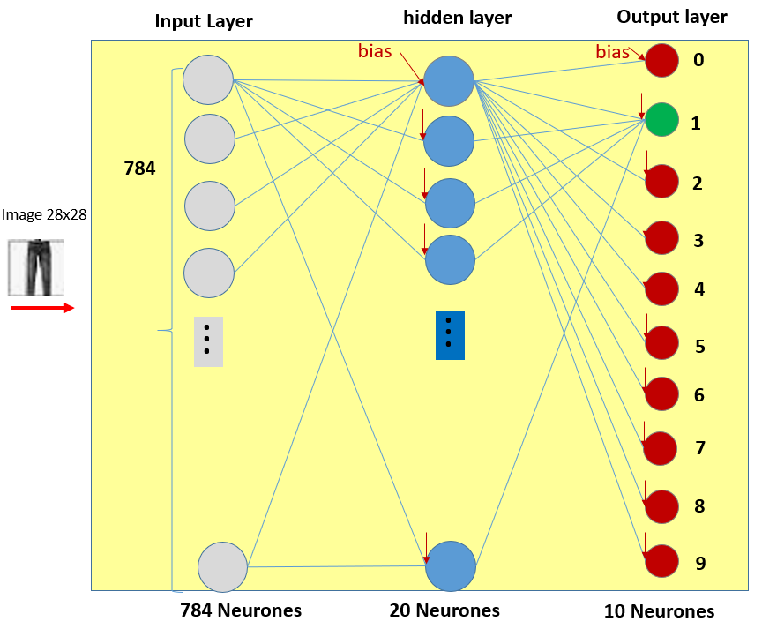
3. Prediction
yp=model.predict(np.array([X_test[2]]))
array([[0., 1., 0., 0., 0., 0., 0., 0., 0., 0.]]
X_test[2]
classes = ["T-shirt/top","Trouser","Pullover","Dress","Coat","Sandal","Shirt","Sneaker","Bag","Ankle boot"]
classes[np.argmax(yp)]
yp = model.predict(X_test)
classes[np.argmax(yp[2])]

Slide 18
Les étapes à suivre pour créer le modèle
Data
Get data, Features (X), target (y)
Visualize data
Split Data (training data, test data)
Model
Create the model, compile the model: keras, tensorflow
Loss function: sparse_categorical_crossentropy
Train the model
Parameters
Prediction
Evaluation

Slide 19
2. Evaluation
print(model.metrics_names)
['loss', 'accuracy’]
metrics=model.evaluate(X_test,y_test)
print(metrics)
[0.4006, 0.8568]

Slide 20
Exercice 1
Refaire le même travail
Essayes d’améliorer la performance du modèle
Ajouter une autre couche cachée
Evaluer le modèle obtenu

Slide 21
Exercice 2
Traiter le problème de classification des digits

Slide 22
Exercice 3
Traiter le problème de classification des diabetes

